Slide 1







John Deardurff
Microsoft Customer Engineer (Global Technical Team)
Microsoft Certified Trainer (Regional Lead)
MVP: Data Platform (2016 – 2018)
Email: John.Deardurff@Microsoft.com
Twitter: @SQLMCT
Website: www.SQLMCT.com
GitHub: github.com\SQLMCT

Slide 2
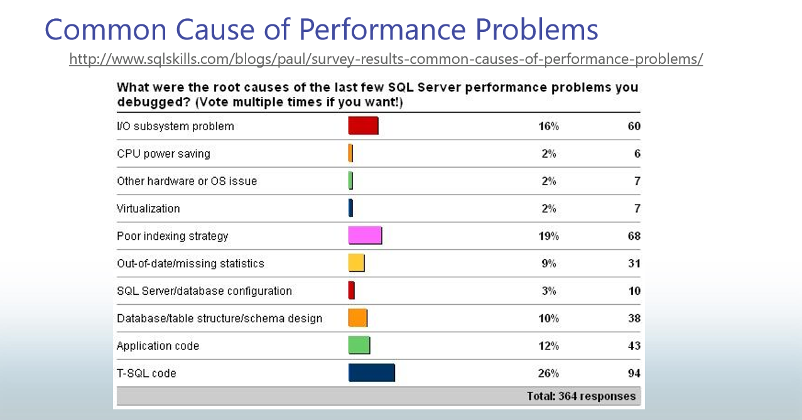

Slide 3
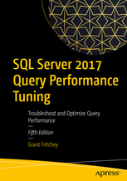
SQL Server Performance Killers
Poor Indexing
Inaccurate Statistics
Poor Query Design
Poor Execution Plans
Excessive blocking and deadlocks
Non set-based operations
Poor database design
Excessive fragmentation
Non-reusable execution plans
Frequent recompilation of queries
Improper use of cursors
Improper configuration of database log
Excessive use or improper configuration of tempdb

Slide 4
Two Main Functions of SQLOS
Management
Memory Manager
Monitoring
Resource Monitor
Process Scheduler
Synchronization
I/O
Support for Non-Uniform Memory Access (NUMA) and Resource Governor
Deadlock Monitor
Scheduler Monitor
Lazy Writer (Buffer Pool management)
Dynamic Management Views (DMVs)
Extended Events
Dedicated Administrator Connection (DAC)
Microsoft Confidential
Notes:
Key Points:
The two core responsibilities of the SQLOS are Resource Management and Monitoring. All the information used to manage and monitor resources within the SQL Server process space is exposed to the DBA via Dynamic Management Views (DMVs). These views expose the memory structures used within the SQLOS to account for all the resources in use, thus giving the DBA complete knowledge of the state of the SQL Server process.

Slide 5
Dynamic Management Views and Functions
Category | Description
sys.dm_exec_% | Execution and connection information
sys.dm_os_% | Operating system related information
sys.dm_tran_% | Transaction management information
sys.dm_io_% | I/O related information
sys.dm_db_% | Database information
Notes:
While all this has been running, several other parts of SQLOS have been active:
Monitoring: DMVs, Extended Events (xEvents), and so on.
Deadlock Monitor thread: Monitors for and deals with deadlocks.
Lazy Writer threads: Clock sweeping the buffer pool to maintain the free lists and responsible for writing dirty pages to disk between checkpoints.
Scheduler Monitor thread: Monitors scheduler health and detects issues such as non-yielding scenarios.
Resource Monitor thread: Monitors available memory from operating system and internal to SQL Server and notifies the Clerks.
The Hosting APIs for external components interface with Microsoft Data Access Components (MDAC) and common language runtime (CLR).

Slide 6
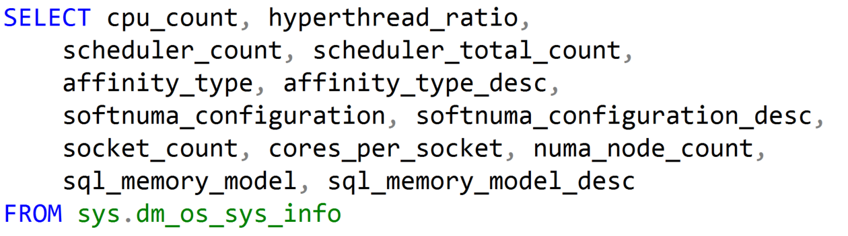
Using Dynamic Management Objects (DMOs)
Must reference using the sys schema
Two basic types:
Real-time state information
Historical information
Notes:
While all this has been running, several other parts of SQLOS have been active:
Monitoring: DMVs, Extended Events (xEvents), and so on.
Deadlock Monitor thread: Monitors for and deals with deadlocks.
Lazy Writer threads: Clock sweeping the buffer pool to maintain the free lists and responsible for writing dirty pages to disk between checkpoints.
Scheduler Monitor thread: Monitors scheduler health and detects issues such as non-yielding scenarios.
Resource Monitor thread: Monitors available memory from operating system and internal to SQL Server and notifies the Clerks.
The Hosting APIs for external components interface with Microsoft Data Access Components (MDAC) and common language runtime (CLR).

Slide 7
Yielding
Runnable List
Status: runnable
CPU available
Start
CPU
Status: running
Complete
Quantum exhausted
End
Resource blocked
Waiter List
Status: suspended
Resource available

Slide 8
Thread States and Queues
Runnable: The thread is currently in the Runnable Queue waiting to execute. (First In, First Out).
Running: One active thread executing on a processor.
Suspended: Placed on a Waiter List waiting for a resource other than a processor. (No specific order).
Notes:
10987B
1: SQL Server Architecture, Scheduling, and Waits

Slide 9
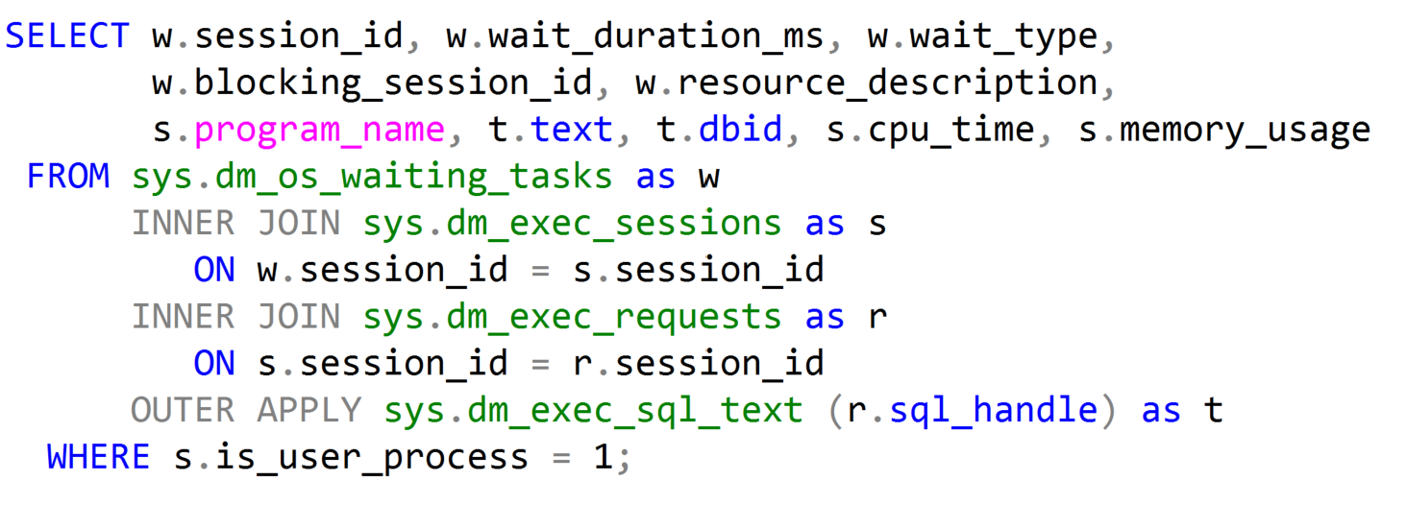
Waiting Tasks DMV
Notes:
Key Points:
Use sys.dm_os_waiting_tasks to show the waiter list at the current moment. sys.dm_exec_requests contains all requests (running, runnable, waiting) that are in-flight, and joining both these DMVs allows us to find what is causing blocking at a given point in time.
Additional Reading:
SQL Swiss Army Knife #11.1 - Locking, blocking and active transactions (http://blogs.msdn.com/b/blogdoezequiel/archive/2012/09/18/sql-swiss-army-knife-11-1-locking-blocking-and-active-transactions.aspx)
Key Points:
The overwhelming majority of scenarios we focus our attention on Resource waits, which may indicate bottlenecks that we have to deal with.
SQL Server bottlenecks may present themselves in different ways:
We might face CPU contention with high CPU consumption and this will have an effect on waits.
Or we might face a situation where available memory is low, also leading to specific wait types.
Disk I/O is also very important, because disk high latencies can slow down any and all operations in SQL Server, and there are specific waits that allow us to scope further actions.
Network I/O should not be overlooked. We might have low bandwidth available, or clients may not be consuming data as fast as SQL Server can provide it – all these have specific cumulative waits in SQL Server.
Then there is transactional locking and blocking, which is paramount for our workload performance, as it represents contention on queries.
The order listed above is not arbitrary. This is the order in which we usually start troubleshooting SQL Server bottlenecks.
Please check if this should be the “waits” list
This sentence reads wrong. Consider changing to “Of all the scenarios that are available, we focus our attention on..”?
Global: Please avoid using first person “we”, “I”, or “our”. Always use “you” or “Microsoft” if that is applicable.

Slide 10
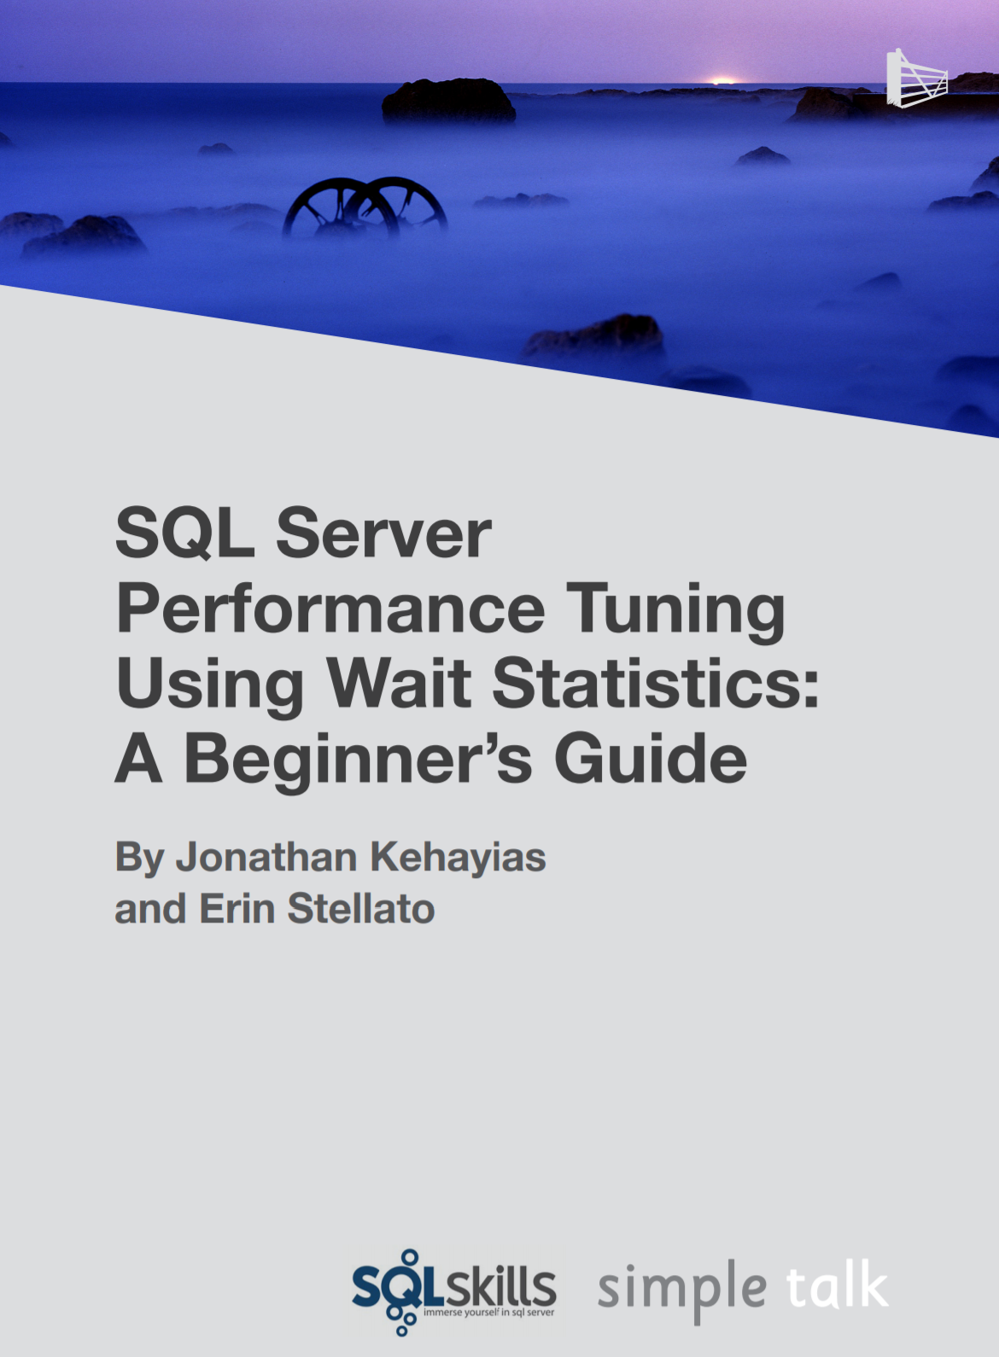
Troubleshooting Wait Types
Aaron Bertrand – Top Wait Types https://sqlperformance.com/2018/10/sql-performance/top-wait-stats
Paul Randal – SQL Skills Wait Types Library https://www.sqlskills.com/help/waits/
Notes:
10987B
1: SQL Server Architecture, Scheduling, and Waits

Slide 11
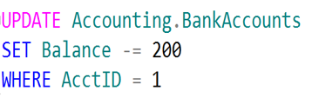
SQL Server Disk I/O (Write-Ahead Logging)
4
1. Data modification is sent to buffer cache in memory.
1
2
4. Log cache record is flushed to the transaction log
2. Modification is recorded in the log cache.
3
5. At checkpoint, dirty data pages are written to the database file.
Data Page
Data Row
3. Data pages are located or read into the buffer cache and then modified.
Data Row
5
Data Row
Free Space
Notes:
Key Points:
SQL Server uses the buffer pool to minimize the amount of disk I/O that must be done against the data file. When a page is required for a read or write operation, the buffer pool is checked first. If the page is already in the buffer pool, the operation can be satisfied from memory only.
When a modification happens, the change is made to the data page in memory first, and then a log record is written to the transaction log file. The page will not be written out to disk until the CHECKPOINT process comes through and flushes changes out to the data file. If the SQL Server process is shut down unexpectedly and the memory space is lost, SQL Server uses the transaction log to bring the data file up to date with any changes that were committed before the crash but not persisted to disk. This is called recovery.
To optimize the I/O, SQL Server will attempt to gather pages together so that larger chunks of a file can be read or written in a single operation. For reads, SQL Server has a read ahead mechanism that will read contiguous pages from an object in a single request if needed by a query. For writes, SQL Server will gather together a chunk of contiguous pages that have been modified so they can be written in a single request.
Additional Reading:
ACID properties (http://msdn.microsoft.com/en-us/library/aa480356.aspx)
Write-Ahead Transaction Log (http://msdn.microsoft.com/en-us/library/ms186259.aspx)
Writing Pages (http://msdn.microsoft.com/en-us/library/aa337560.aspx)
Analyzing I/O Characteristics and Sizing Storage Systems for SQL Server Database Applications (http://msdn.microsoft.com/en-us/library/ee410782.aspx)
Understanding Logging and Recovery in SQL Server (http://technet.microsoft.com/en-us/magazine/2009.02.logging.aspx)
Please check if this is supposed to be a single word.

Slide 12
SQL Server Object Allocation
Data Row
Data Row
Data Row
Free Space
Data Row
Free Space
Data Row
Data Row
Data Row
Data Row
Free Space
Data Row
Free Space
Free Space
Free Space
Free Space
Data Row
Data Row
Data Row
Data Row
Data Row
Data Row
Free Space
Data Row
Data Row
Data Row
Data Row
Free Space
Data Row
Data Row
Free Space
Free Space
Primary Data File (.mdf)
Secondary Data File (.ndf)
Extent: Eight contiguous 8kb pages
Uniform extents: Pages used by a single object.
Mixed extents: Pages used by different objects.
Notes:
Databases are composed of 64 kilobytes (KB) extents
Extents are the basic unit used by SQL Server to manage space. An extent is eight physically contiguous pages, or 64 kilobytes (KB). SQL Server has two types of extents:
Uniform extents are owned by a single object, and only the owning object can use the eight pages in the extent.
Mixed extents contain eight pages that can be used by different objects.
Each extent is composed of eight pages of 8 KB each
To make its space allocation efficient, SQL Server does not allocate an entire extent to tables that contain small amounts of data. A new table or index is usually allocated using pages from mixed extents. When the table or index grows to the point where it needs to allocate more than 8 pages, then all allocations of new space will be done in uniform extents, but the original pages on mixed extents will not be moved into uniform extents. If you create an index on an existing table that has enough rows to generate eight pages in the index, all allocations of new space are uniform extents.
Allocation maps track allocations
SQL Server uses two types of allocation maps to record the allocation of extents:
Global Allocation Map (GAM). GAM pages record all extents. Each GAM covers 63,904 extents, or nearly 4 gigabytes (GB) of data. The GAM has one bit for each extent in the interval that it covers. If the bit is 1, the extent is free; if the bit is 0, the extent is allocated.
Shared Global Allocation Map (SGAM). SGAM pages record those extents that are currently used as mixed extents and have at least one unused page. Each SGAM covers 63,904 extents, or nearly 4 GB of data. The SGAM has one bit for each extent in the interval that it covers. If the bit is 1, the extent is being used as a mixed extent and has free pages; if the bit is 0, the extent is not used as a mixed extent, or it is a mixed extent whose all pages are in use.

Slide 13
Basic Page Structure
Page Header
(96 bytes)
Header contains Page Information such a Page Number and Page Type
Data Row 1
Data Row 2
Data Row 3
8060 bytes for Data Rows or Free Space
Free Space
Row Offset Array
Displays how far from beginning of page each row is located.
Notes:
Databases are composed of 64 kilobytes (KB) extents
Extents are the basic unit used by SQL Server to manage space. An extent is eight physically contiguous pages, or 64 kilobytes (KB). SQL Server has two types of extents:
Uniform extents are owned by a single object, and only the owning object can use the eight pages in the extent.
Mixed extents contain eight pages that can be used by different objects.
Each extent is composed of eight pages of 8 KB each
To make its space allocation efficient, SQL Server does not allocate an entire extent to tables that contain small amounts of data. A new table or index is usually allocated using pages from mixed extents. When the table or index grows to the point where it needs to allocate more than 8 pages, then all allocations of new space will be done in uniform extents, but the original pages on mixed extents will not be moved into uniform extents. If you create an index on an existing table that has enough rows to generate eight pages in the index, all allocations of new space are uniform extents.
Allocation maps track allocations
SQL Server uses two types of allocation maps to record the allocation of extents:
Global Allocation Map (GAM). GAM pages record all extents. Each GAM covers 63,904 extents, or nearly 4 gigabytes (GB) of data. The GAM has one bit for each extent in the interval that it covers. If the bit is 1, the extent is free; if the bit is 0, the extent is allocated.
Shared Global Allocation Map (SGAM). SGAM pages record those extents that are currently used as mixed extents and have at least one unused page. Each SGAM covers 63,904 extents, or nearly 4 GB of data. The SGAM has one bit for each extent in the interval that it covers. If the bit is 1, the extent is being used as a mixed extent and has free pages; if the bit is 0, the extent is not used as a mixed extent, or it is a mixed extent whose all pages are in use.

Slide 14
SQL Server Buffer Pool
Stores 8 kilobytes (KB) pages of data to avoid repeated disk I/O.
Pages held in the buffer until the space is needed by something else.
Lazy Writer searches for eligible buffers.
If the buffer is dirty, an asynchronous write (lazy write) is posted so that the buffer can later be freed.
If the buffer is not dirty, it is freed.
Physical
Read
Logical
Read
Buffer Pool
Memory
Disks
Notes:
Key Points:
The buffer pool generally represents the largest percentage of SQL Server memory. In NUMA systems, there will be a separate buffer pool node for each NUMA node.
The buffer pool abstracts the physical location of data and provides caching functions. All data accessed by SQL Server goes through the buffer pool. Therefore, the buffer pool can determine the data that should be stored in the cache to boost performance for frequently used objects.
There are two ways that the data is accessed from the buffer pool:
Logical read. Indicates that the data requested is already present in the cache. A logical read-only involves memory access, so the response time is optimum.
Physical read. Indicates that the data requested is not present in the cache, so the data must be found by using the database files. A physical read is a disk I/O operation, which is more expensive than memory access. When the I/O operation completes, the request is satisfied and the data is stored in the cache so that it can be accessed later.
When a query runs, the database pages that contain the data required to return the query result may or may not be located in physical memory. The query does not have the notion of data locality; it simply requests the page from the buffer pool.
If the pages are in memory, then there is a logical read of the page, which results in a cache hit. If the page is not in memory, then there needs to be a physical read of the page from the disk subsystem. This results in a cache miss event.
Additional Reading:
Buffer Management
https://docs.microsoft.com/en-us/previous-versions/sql/sql-server-2008-r2/aa337525(v=sql.105)
Growing and Shrinking the Buffer Pool Under NUMA
https://docs.microsoft.com/en-us/previous-versions/sql/sql-server-2008-r2/ms345403(v=sql.105)

Slide 15
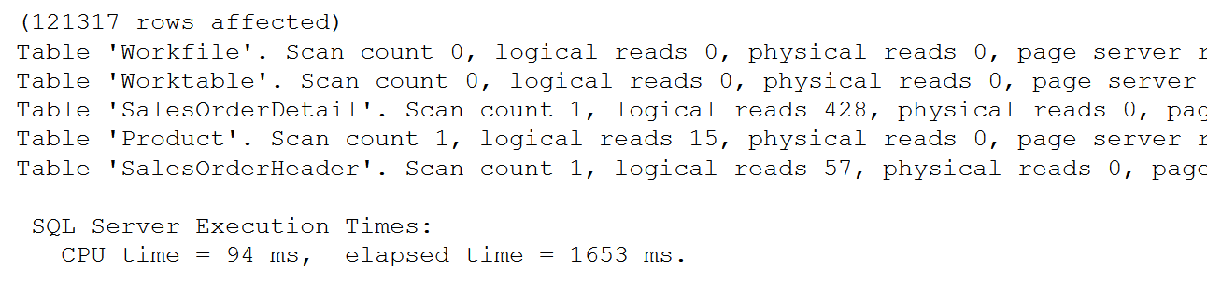
SET STATISTICS IO
SET STATISTICS IO ON
GO
SET STATISTICS TIME ON
SELECT SOH.SalesOrderID, SOH.CustomerID,
OrderQty, UnitPrice, P.Name
FROM Sales.SalesOrderHeader AS SOH
JOIN Sales.SalesOrderDetail AS SOD
ON SOH.SalesOrderID = SOD.SalesOrderID
JOIN Production.Product AS P
ON P.ProductID = SOD.ProductID
SET STATISTICS IO, TIME OFF
Monitor Physical Reads & Logical Reads
Notes:
SET STATISTICS IO (Transact-SQL) - SQL Server | Microsoft Docs
Causes SQL Server to display information about the amount of disk activity generated by Transact-SQL statements.
SET STATISTICS TIME (Transact-SQL) - SQL Server | Microsoft Docs
Displays the number of milliseconds required to parse, compile, and execute each statement.

Slide 16
Allocation Units
IN_ROW_DATA
LOB_DATA (For out of row storage)
ROW_OVERFLOW_DATA (SLOB)
Fixed length data must be store here.
Rows cannot extend beyond pages
Data Page is 8060 bytes
varchar(max) / nvarchar(max) / varbinary(max)
16-byte point to out of row tree
Uses text page to store a stream of data
varchar(8000) / nvarchar(4000) / varbinary(8000)
When a column can’t fit onto a page
No control over which column overflows

Slide 17
Allocation Structures
Page Free Space (PFS)
Tracks free space on a page (1 Byte/Page )
Covers 64 megabytes (MB) worth of pages
Global Allocation Map (GAM)
Tracks which extents have been allocated (1 Bit)
Covers 64,000 extents (4 gigabytes (GB) worth of data)
Shared Global Allocation Map (SGAM)
Tracks which extents are used for mixed extent allocations (1 Bit)
Covers 64,000 extents (4 GB worth of data)
Index Allocation Map (IAM)
Tracks which extents are allocated to an allocation unit
Covers 4 GB worth of data
One IAM chain per table, per index, per partition, per allocation unit type
Page Types
Data (1)
Index (2)
Text (3 and 4)
Boot (13)
File Header (15)
PFS (11)
GAM (8)
SGAM (9)
IAM (10)
DIFF_MAP(16)
ML_MAP (17)

Slide 18
Index Allocation Map Pages
SGAM:
00011000000000
GAM:
010110100000
Unallocated Extent
Mixed Extent with free pages
Unallocated Extent
(1:550)
(1:557)
(1:558)
(1:565)
(1:566)
(1:573)
(1:574)
(1:581)
(1:582)
(1:589)
(1:590)
(1:597)
(1:598)
(1:605)
(1:606)
(1:613)
Full Extent
Full Extent
Full Extent
Full Extent
Notes:
SGAM pages record which extents are now used as mixed extents and have at least one unused page. Similar to a GAM, each SGAM covers about 64,000 extents, or almost 4 GB of data. The SGAM has a bit for each extent in the interval it covers. If the bit is 1, the extent being used is a mixed extent and has unallocated pages; if the bit is 0, the extent is not being used as a mixed extent, or it is a mixed extent whose pages are all in use.

Slide 19
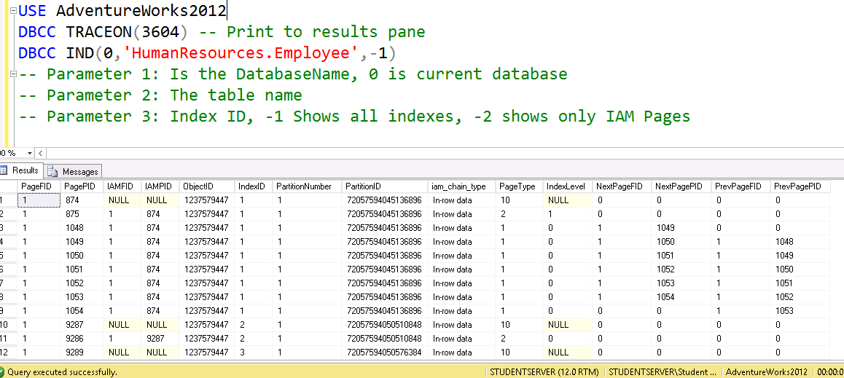
DBCC IND

Slide 20
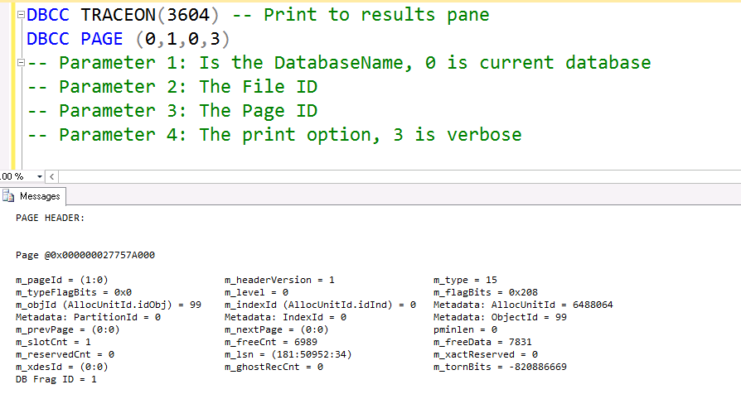
DBCC PAGE

Slide 21
How Data is Stored in Data Pages
Data stored in a Heap is not stored in any order and normally does not have a Primary Key.
Heap
Data Row 8
Data Row 2
Data Row 7
Data Row 6
Data Row 5
Data Row 4
Data Row 1
Data Row 3
Data Row 9
Clustered Index data is stored in sorted order by the Clustering key. In many cases, this is the same value as the Primary Key.
Clustered Index
Data Row 1
Data Row 4
Data Row 7
Data Row 2
Data Row 5
Data Row 8
Data Row 3
Data Row 6
Data Row 9

Slide 22
Characteristics of a Good Clustering Key
Narrow
Unique
Static
Increasing
Use a data type with a small number of bytes to conserver space in tables and indexes
To avoid SQL adding a 4-byte uniquifier
Allows data to stay constant without constant changes which could lead to page splits
Allows better write performance and reduces fragmentation issues

Slide 23
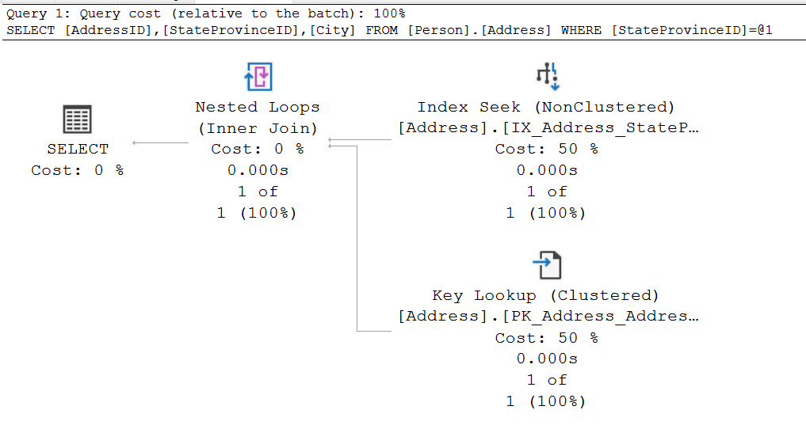
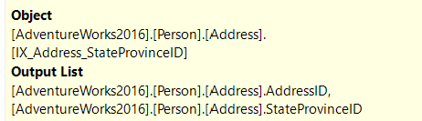

Key Lookup
Notes:
Key Points:
When nonclustered indexes are used, SQL Server may choose to use a different access method.
When the nonclustered index is sought or scanned, it is doing so to support WHERE clauses and JOINs.
However, the nonclustered index often cannot support the SELECT clause hence need to join with base table.
To put it another way, it cannot ‘cover’ the query.
=============
More Information
=============
To get the columns needed for the select clause, SQL Server needs to look up those additional columns using a Key Lookup, which reaches back to the clustered index or heap.
This is possible because each row in the nonclustered index has not only the columns that were defined, but also includes the clustering key or RID.
When the nonclustered index seek/scan finds the rows that match the filter requested, it loops over each of the rows, gets the hidden key/RID, and gets the additional columns needed.
Key lookups are costly. In fact, they are so costly that SQL Server frequently decides that the cost of a nonclustered index seek + lookup is higher than simply scanning the clustered index.
To improve Query performance one must remove the lookup from the Execution plan.
The ‘tipping point’ that determines when SQL Server will scan is pretty low, and is typically 10%.
Therefore, avoiding key lookups is often a good way to help query performance. The next lesson, “Indexing Strategy”, discusses ways that this can be done.

Slide 24
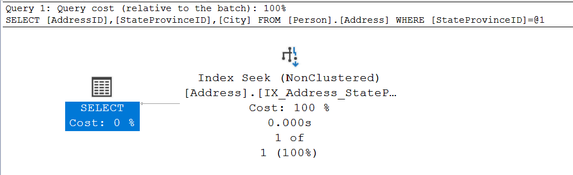
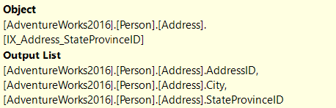
Non-Clustered Index with Included Column
Notes:
Key Points:
When nonclustered indexes are used, SQL Server may choose to use a different access method.
When the nonclustered index is sought or scanned, it is doing so to support WHERE clauses and JOINs.
However, the nonclustered index often cannot support the SELECT clause hence need to join with base table.
To put it another way, it cannot ‘cover’ the query.
=============
More Information
=============
To get the columns needed for the select clause, SQL Server needs to look up those additional columns using a Key Lookup, which reaches back to the clustered index or heap.
This is possible because each row in the nonclustered index has not only the columns that were defined, but also includes the clustering key or RID.
When the nonclustered index seek/scan finds the rows that match the filter requested, it loops over each of the rows, gets the hidden key/RID, and gets the additional columns needed.
Key lookups are costly. In fact, they are so costly that SQL Server frequently decides that the cost of a nonclustered index seek + lookup is higher than simply scanning the clustered index.
To improve Query performance one must remove the lookup from the Execution plan.
The ‘tipping point’ that determines when SQL Server will scan is pretty low, and is typically 10%.
Therefore, avoiding key lookups is often a good way to help query performance. The next lesson, “Indexing Strategy”, discusses ways that this can be done.

Slide 25
How to determine Thread Stack Memory
Maximum Worker Threads
512 + (Processors -4) *16
*
2mb per thread
Cores | Threads | Memory (MB)
4 | 512 | 1,024
8 | 576 | 1,152
16 | 704 | 1,408
32 | 960 | 1,920
64 | 1,472 | 2,944
80 | 1,728 | 3,456
Notes:
In SQL Server 2012, the max server memory setting now controls all memory allocations that were previously made through the single_page_allocator AND multi_page_allocator. While SQL CLR memory allocations come directly from VAS via VirtualAlloc, they are accounted for by the memory manager and thus are controlled by max server memory. As a result, SQL Server 2012 max server memory configuration excludes only the following allocations:
Memory allocations for thread stacks within the SQL Server process.
Memory allocation requests made directly to Windows. Examples: Allocations from extended stored procedure DLLs, objects created using OLE Automation procedures (sp_OA calls), and allocations from linked server providers
The amount of memory that is not controlled by max server memory will vary greatly from environment to environment. It will depend on the hardware in use, the number of worker threads, the use of any third-party DLLs, and so on. As an example, on the x64 platform, each thread has a 2 megabytes (MB) stack size. The default maximum number of worker threads can be calculated by using the following formula:
Maximum worker threads = (512+ (<# of processors> -4) * 16)
Therefore, on a system with 16 cores, the maximum number of worker threads will be 704. Multiply that by 2 MB per thread and you end up with 1,408 MB of memory for just the thread stacks in addition to what is being used by the memory manager. This should be kept in mind when estimating SQL Server memory usage for a particular instance and considered when configuring max server memory.
Additional Reading:
Memory configuration and sizing considerations in SQL Server 2012
http://support.microsoft.com/kb/2663912
Is there a reason why this AND is all caps? Unless you are referring to the Boolean operator, please change to lower case
Please define VAS

Slide 26
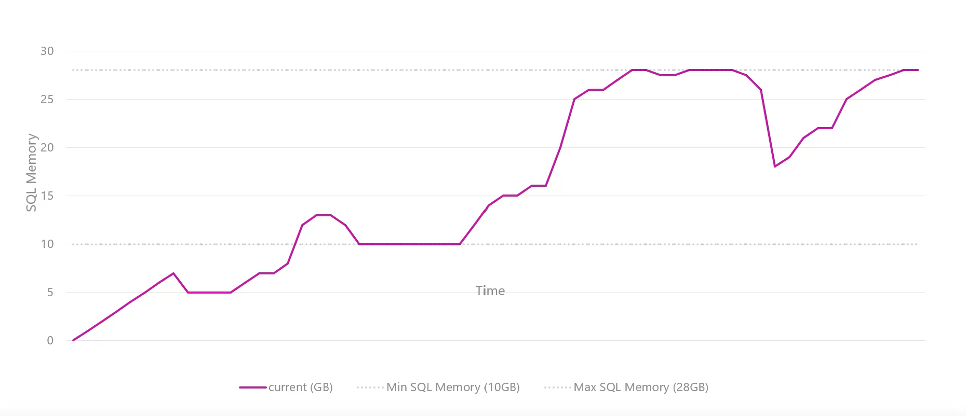
Dynamic Memory Management
Notes:
Key Points:
Low memory conditions are typically related to one of the following issues:
Buffer pool. The database caching mechanism must grow the buffer pool to improve the response time, but there is no memory remaining to do this.
VAS. Different components fail when trying to use memory because there is no VAS available.
Windows memory manager. The operating system is starting the trimming process to meet the needs of a process that is requesting memory. At this moment, SQL Server needs to discard memory to prevent it from being paged out to disk.
The Resource Monitor works in conjunction with the Windows Memory Manager and the SQL Server Memory Manager to monitor the availability of virtual and physical memory, internal cache memory targets, and the Resource Governor Pool limits. When a low memory condition is detected, notifications are passed to memory clerks who attempt to free the memory, if possible, from the various SQL Server components. Each clerk responds to the notifications in different ways depending on the component that implements the clerk. For example, the buffer pool trims memory by activating the Lazy Writer thread, while the CLR clerk may initiate Garbage Collection, and so on.

Slide 27
What is a Transaction?
A transaction is a series of one or more statements that need to operate as a single logical unit of work.
To qualify as a transaction, the logical unit of work must possess all four of the ACID properties.

Slide 28


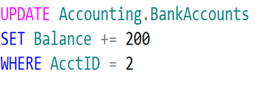
Logical Units of Work – Auto Commit Transactions
$200
John
Jane
Transaction 1
Transaction 2

Slide 29
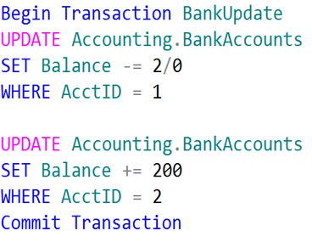
Single Logical Unit of Work – Explicit Transactions
John
Jane
Transaction 1
$200

Slide 30
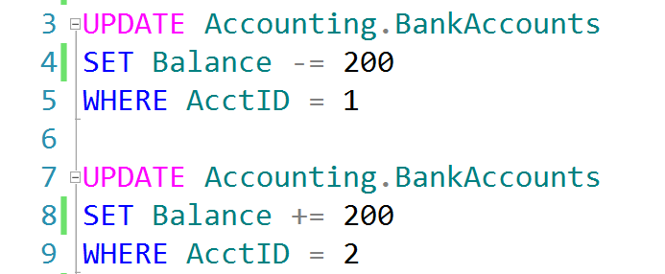
Auto-Commit Transactions without Error Handling
AdventureWorks.ldf
Checkpoint
AdventureWorks.mdf
John, don’t forget to demonstrate
SET XACT_ABORT ON

Slide 31
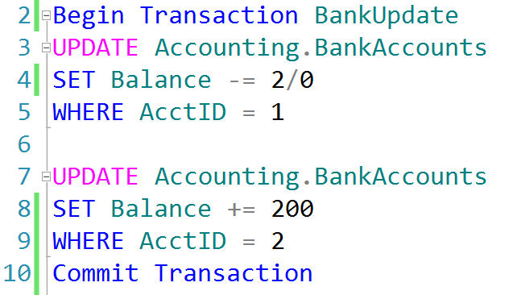
Explicit Transactions without Error Handling
AdventureWorks.ldf
Checkpoint
AdventureWorks.mdf

Slide 32
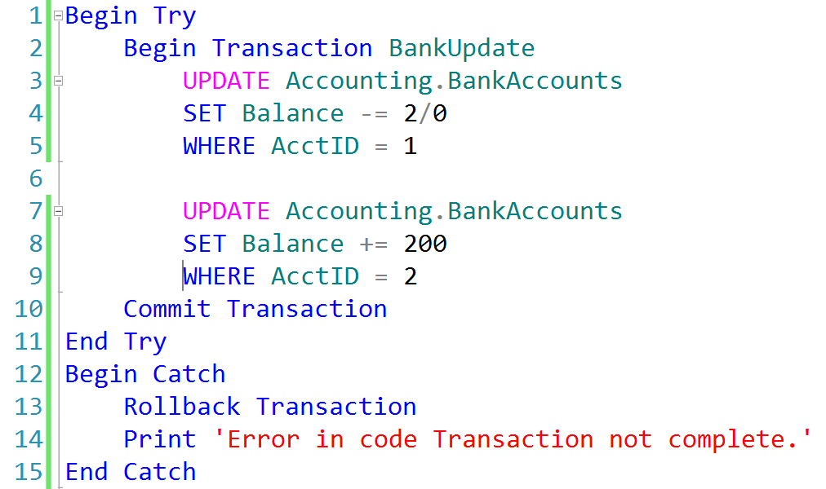
Explicit Transactions with Error Handling
AdventureWorks.ldf
AdventureWorks.mdf
Checkpoint

Slide 33
Transactions must pass the ACID test
Atomicity – All or Nothing
Consistent – Only valid data
Isolated – No interference
Durable – Data is recoverable

Slide 34
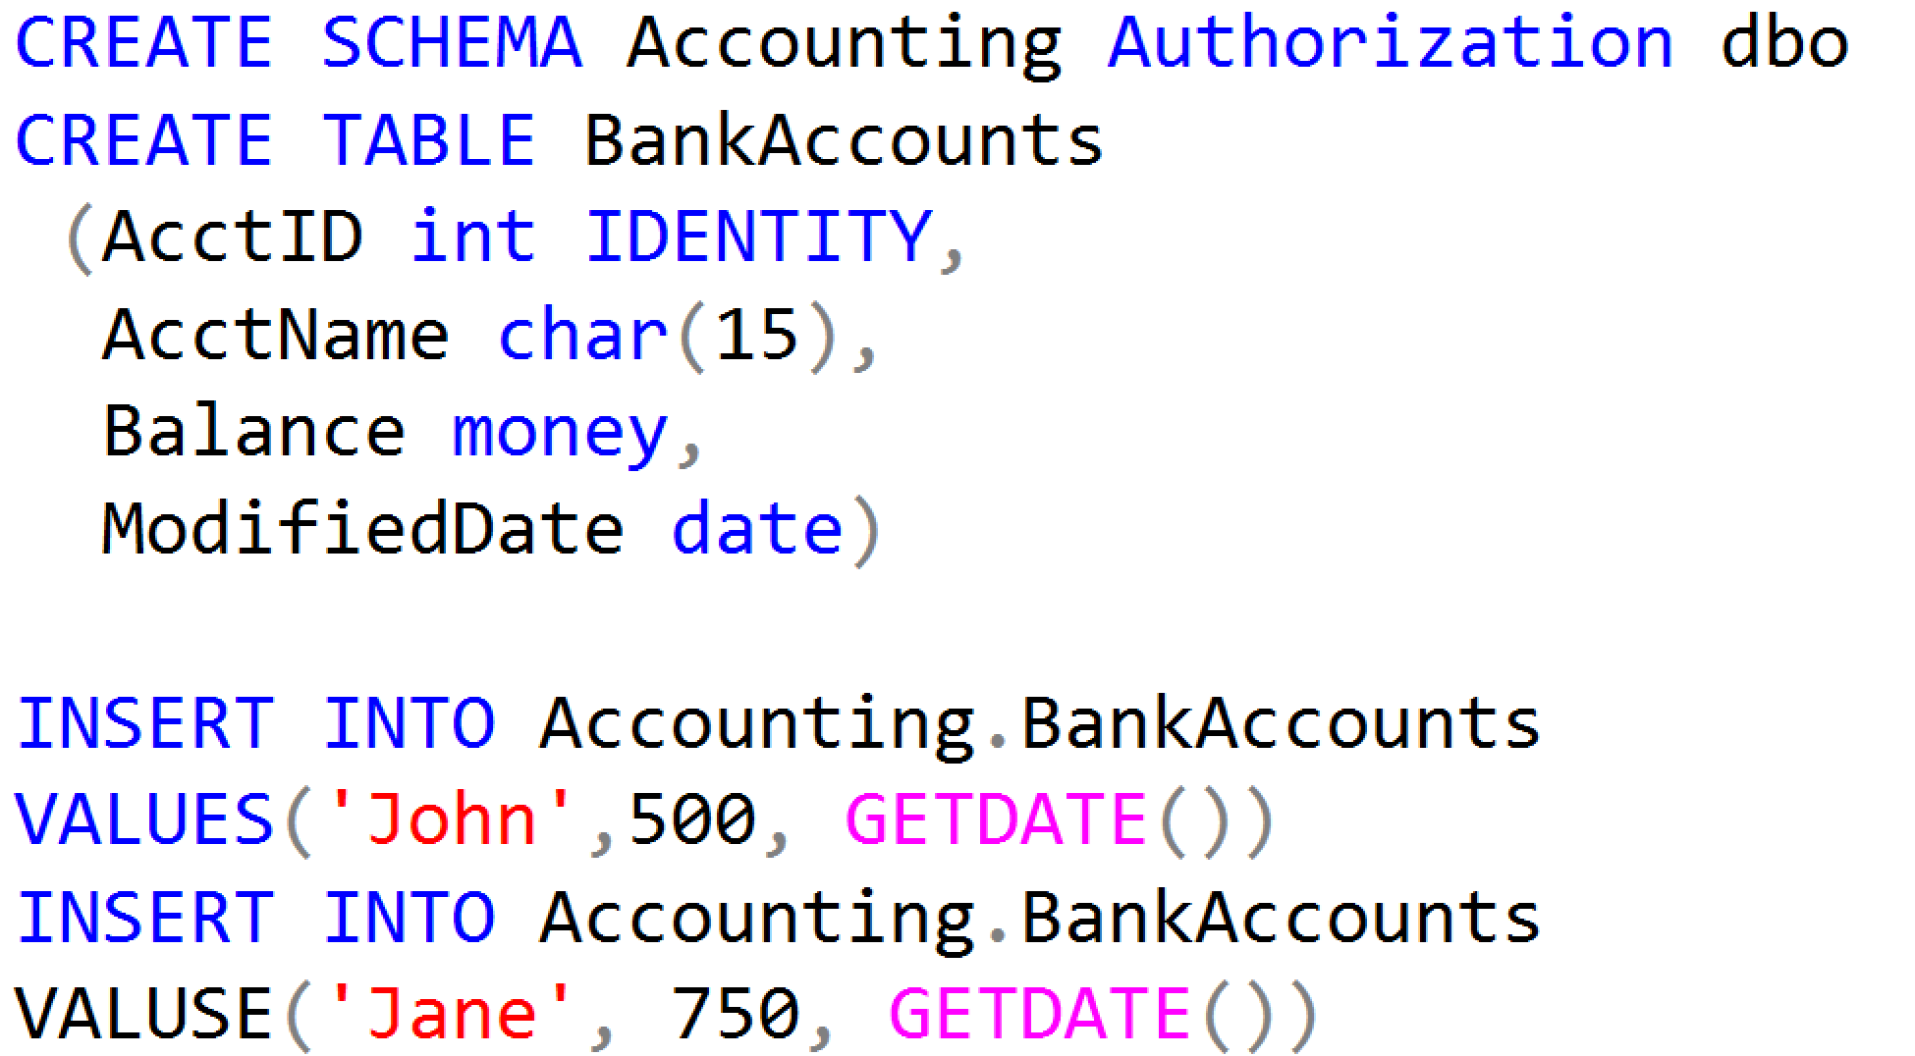
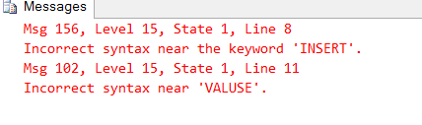
Working with Transactions

Slide 35
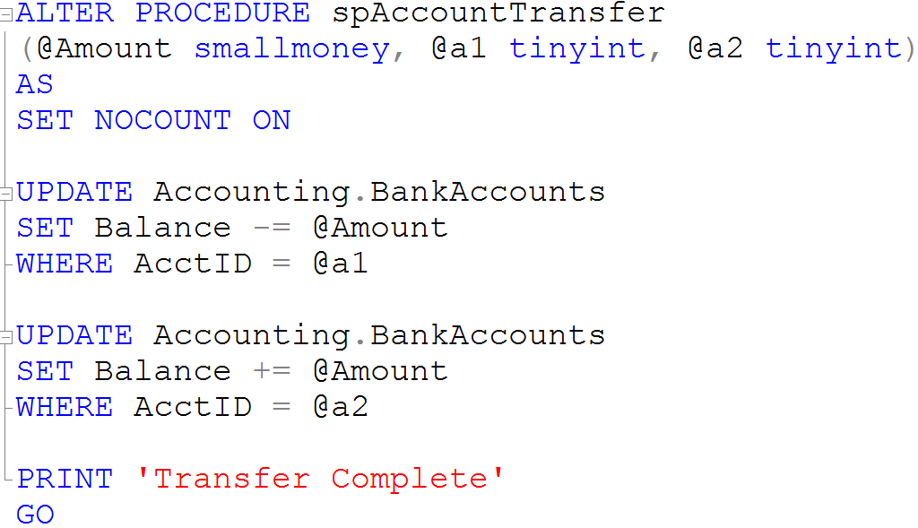
Creating Stored Procedures

Slide 36
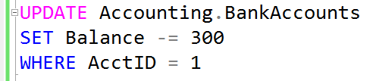
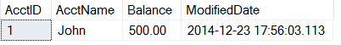

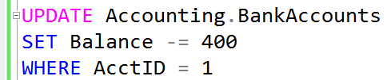
What is a Lock?
Transaction 1
Transaction 2
TSQL2012.mdf

Slide 37
Transaction Isolation Levels
Isolation Level | Dirty Read | Lost Update | Nonrepeatable Read | Phantoms
Read uncommitted | Yes | Yes | Yes | Yes
Read committed (default) | No | Yes | Yes | Yes
Repeatable read | No | No | No | Yes
Serializable | No | No | No | No
Snapshot | No | No | No | No
Notes:
Discuss the effects that each of the transaction isolation levels has on data access. Be sure that students understand the READ COMMITTED isolation level, and that it is the default transaction isolation level.
References:
SET TRANSACTION ISOLATION LEVEL (Transact-SQL): http://go.microsoft.com/fwlink/?LinkID=233927
Transaction Isolation Levels: http://go.microsoft.com/fwlink/?LinkID=209385

Slide 38
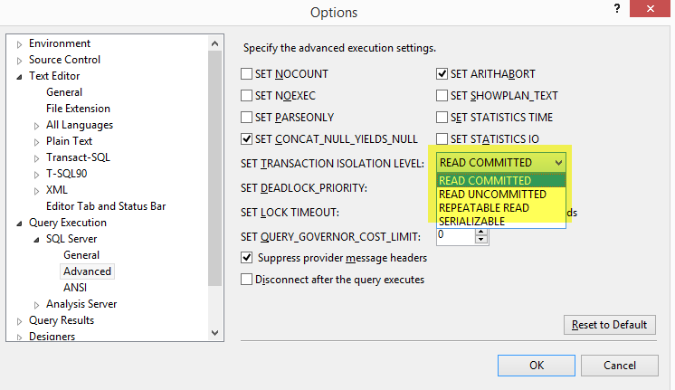
Transaction Isolation Levels
Isolation Levels

Slide 39
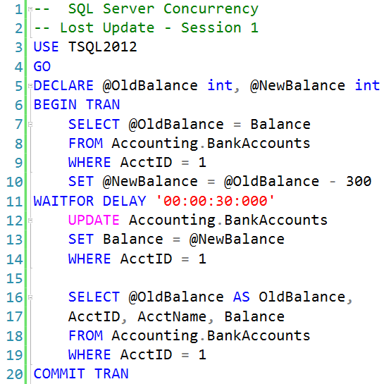
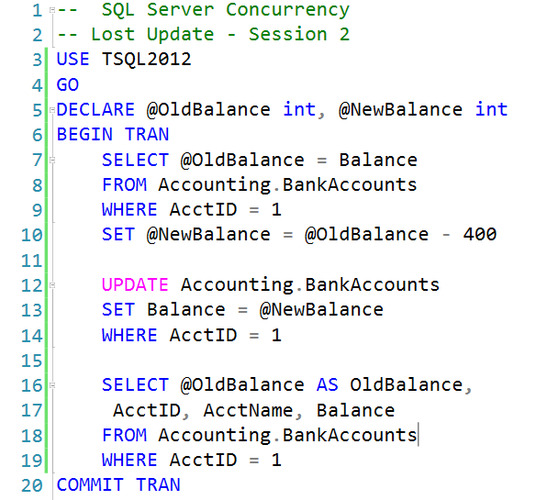
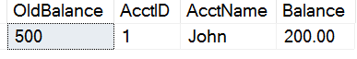
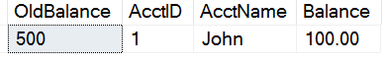
Lost Updates

Slide 40
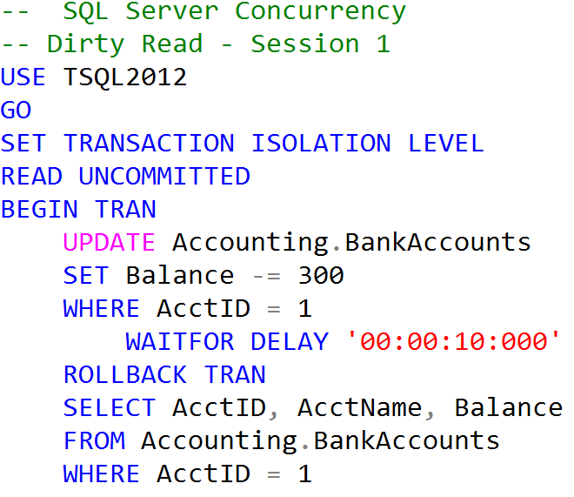
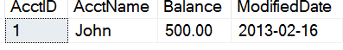
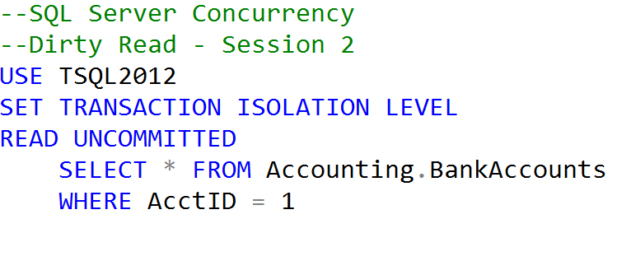
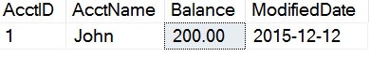
Uncommitted dependency (dirty read)
Clean Read
Dirty Read

Slide 41
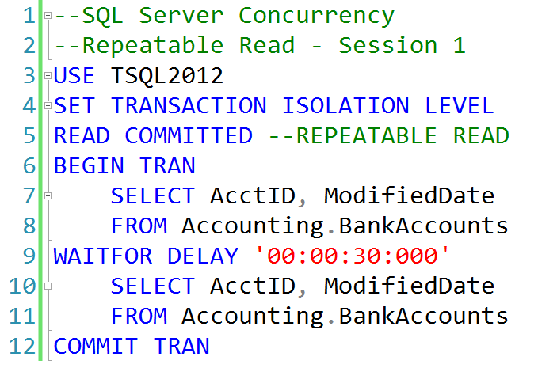
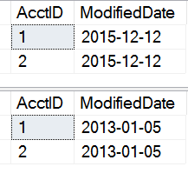
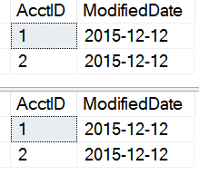
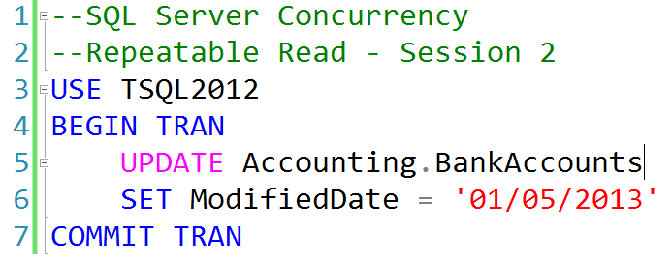
Inconsistent analysis (non-repeatable read)
READ COMMITTED
REPEATABLE READ

Slide 42
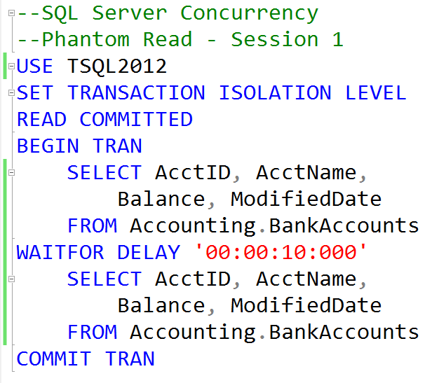
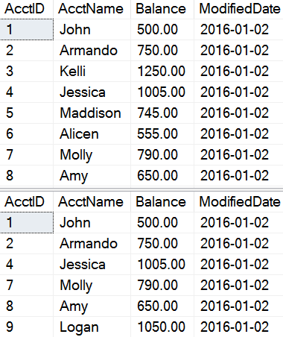
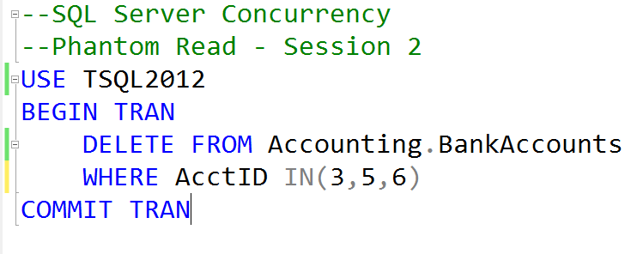
Phantom Reads
Missing records

Slide 43
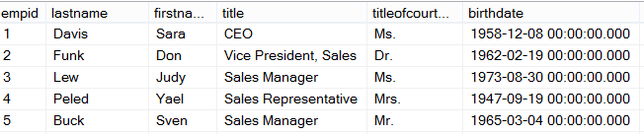
How Queries are Processed
Ad Hoc Query
Stored Procedure
First Execution
or Recompile
Syntax
Parse
Execution Context
Resolve
(Binding)
Compile
Optimize
Estimated
Execution Plan
Procedure Cache
Compile
Compile
Actual
Run Time
Execute
Execute
Execute
Execute
SQL
SQL
Sets
Sets

Slide 44
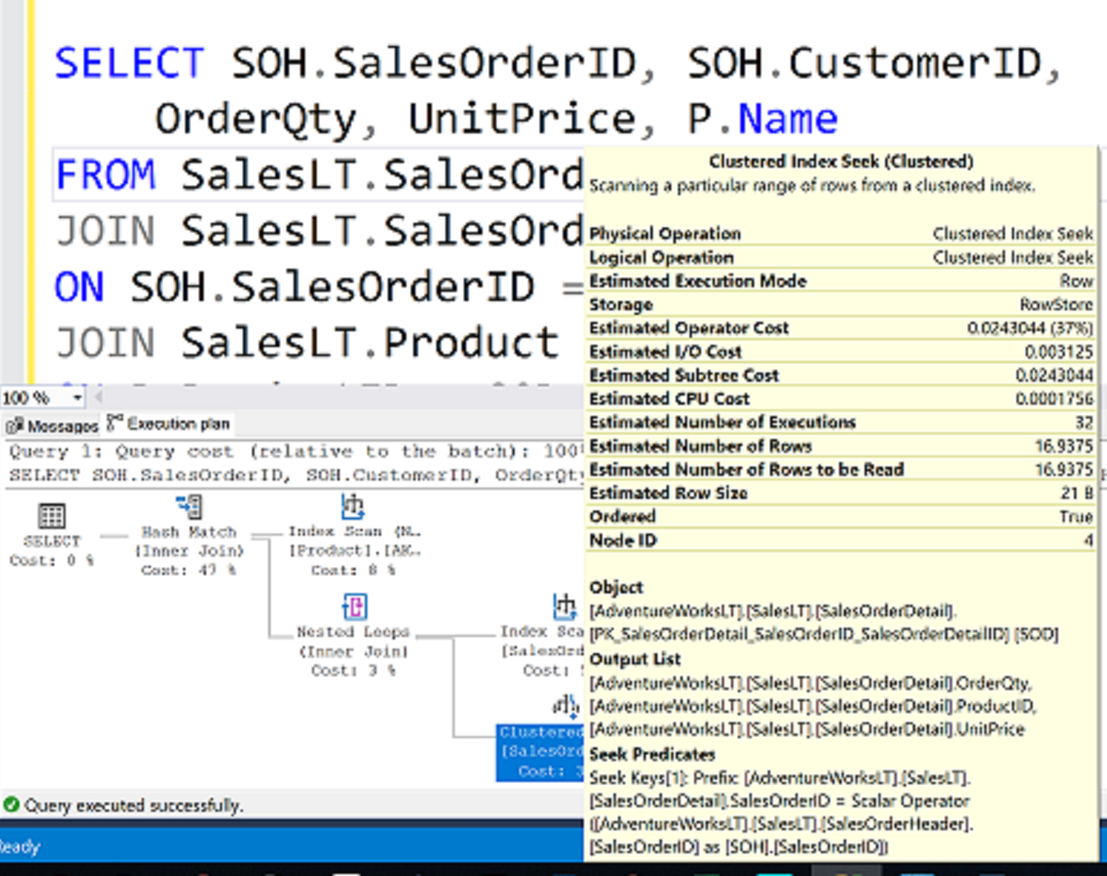
What is an Execution Plan?

Slide 45
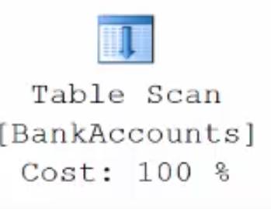
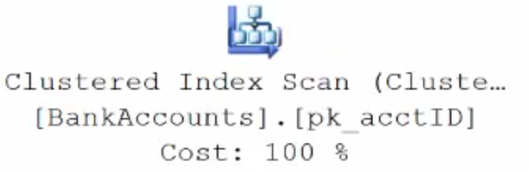
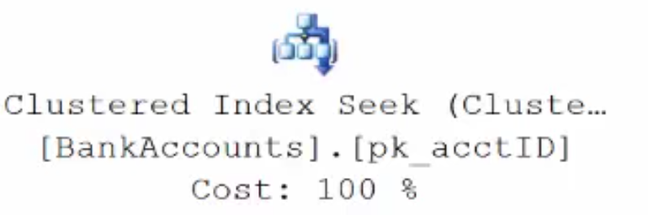
Execution Plan Table Operators
Data stored in a Heap is not stored in any order and normally does not have a Primary Key.
Clustered Index data is stored in sorted order by the Clustering key. In many cases, this is the same value as the Primary Key.
Using a WHERE statement on an Index could possibly have the Execution Plan seek the Index instead of scan.

Slide 46
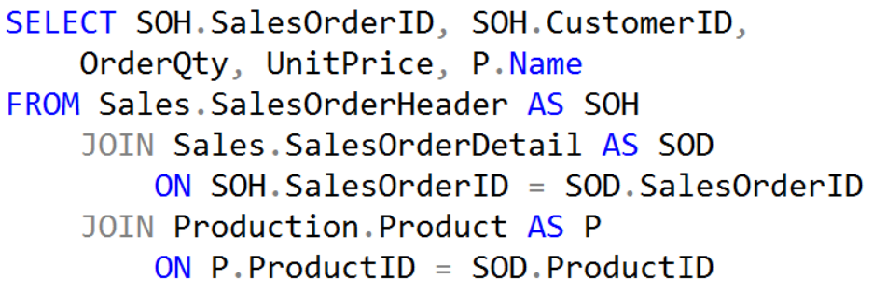
Execution Plan Join Operators (Code)

Slide 47
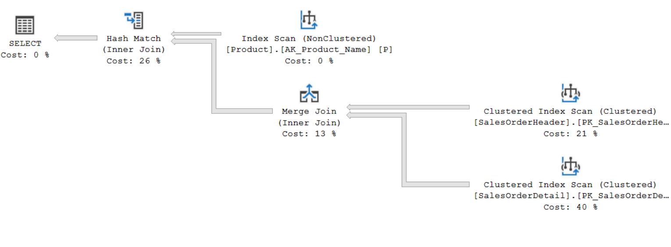
Execution Plan Join Operators (Plan)

Slide 48
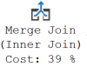
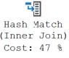

Execution Plan Join Operators
A Merge Join is useful if both table inputs are in the same sorted order on the same value.
A Hash Match is used when the tables being joined are not in the same sorted order.
A Nested Loop is use when a small (outer) table is used to lookup a value in a larger (inner) table.

Slide 49

Parameter Sniffing
Notes:
When a parameterized batch or stored procedure is compiled for the first time, the values of the parameters supplied with the execution call are used to optimize the statements. This process is known as parameter sniffing. If these values are typical, then most calls to that stored procedure will benefit from an efficient query plan.
CREATE PROCEDURE testProc @p1 int = null
AS
BEGIN
If @p1 IS NULL
Begin
Select @p1 = 9999
End
SELECT *
FROM sales.target
WHERE amount = @p1
END
Issues generally arise in two scenarios:
The sniffed parameter value is not typical of the values that are actually used during a typical execution.
The parameter is changed within a stored procedure before it is used in a query-parameterized queries will behave in a similar manner to batches that have been explicitly parameterized. That is, if the first execution of a query uses an atypical value when it is compiled, similar queries that share the execution plan through simple or forced parameterization may have inaccurate cardinality estimates.
Repeat of previous page

Slide 50

Cardinality Estimator and Statistics

Slide 51
Read-Ahead Scans
Read Pages
Read-Ahead
Page 1
Page 2
Page 3
Page 4
Page 5
Page 6
Page 7
Page 8
Read-ahead anticipates the data and index pages needed to fulfill a query execution plan and brings the pages into the buffer cache before they are used by the query.
The read-ahead mechanism allows the Database Engine to read up to 64 contiguous pages (512KB) from one file.
Notes:
Reading Pages - SQL Server | Microsoft Docs

Slide 52
Notes:
Note: This should be the final slide for each presentation.

